Slide 1
















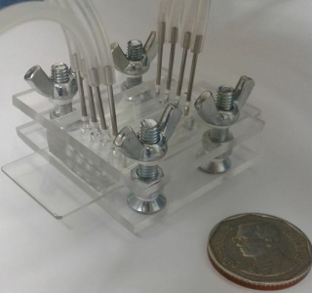




Making Optimization of Biogas Reactors Smarter

